Slide 1
Scoliosis visualization using ultrasound data
Ben Church

Slide 2
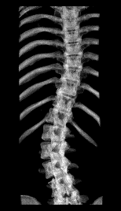
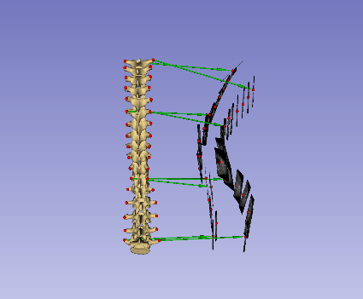
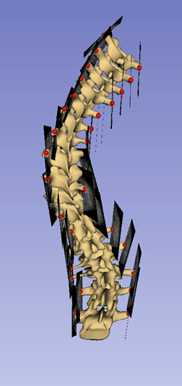
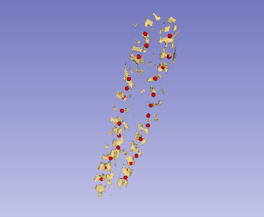
Overview
Ch. 2: Motivation
Ch. 2.2.1: Scoliosis assessment with X-ray
Ch. 2.3: Scoliosis assessment with ultrasound
Ch. 3: Landmark registration for visualization
Ch. 3.4: Registration constraint
Ch. 3.5: Validation
Ch. 4: Landmark generation from ultrasound
Ch. 4.2: Segmentation under-sampling
Ch. 4.3: Landmark refinement
Ch. 4.5: Full workflow test cases

Slide 3

Ch. 2.2.1: Scoliosis assessment with X-ray
Developmentally progressive curvature must be monitored.
Standard assessment metric is the Cobb angle.
X-ray imaging is hazardous and limited [Doody2000], [Presciutti2014].

Slide 4
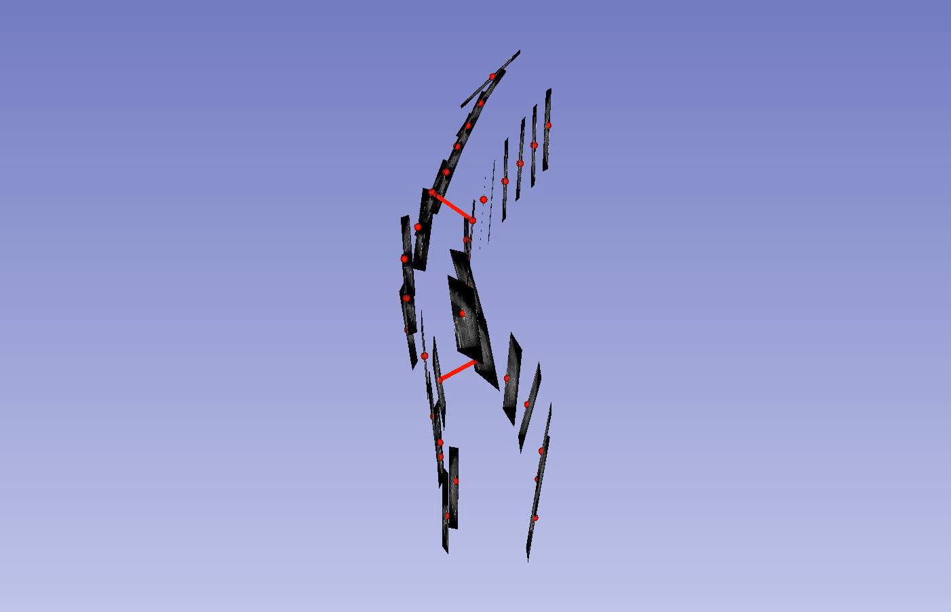
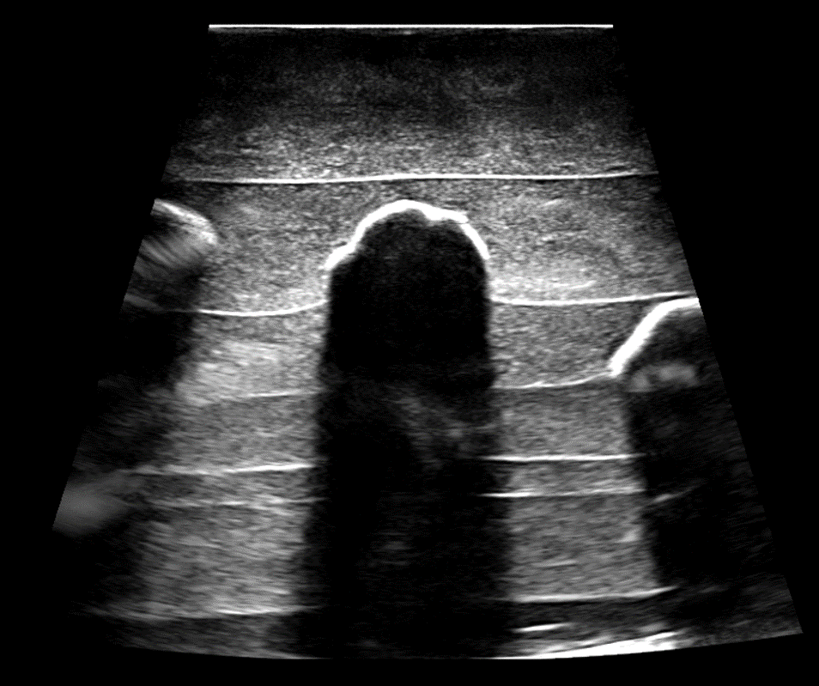
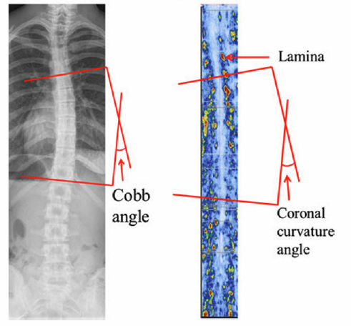
Ch. 2.3: Scoliosis assessment with ultrasound
Tracked ultrasound can be used to locate skeletal landmarks [Purnama2010], [Brudfors2015].
Curvature can be measured from landmarks [Chen2013], [Ungi2014].

Slide 5
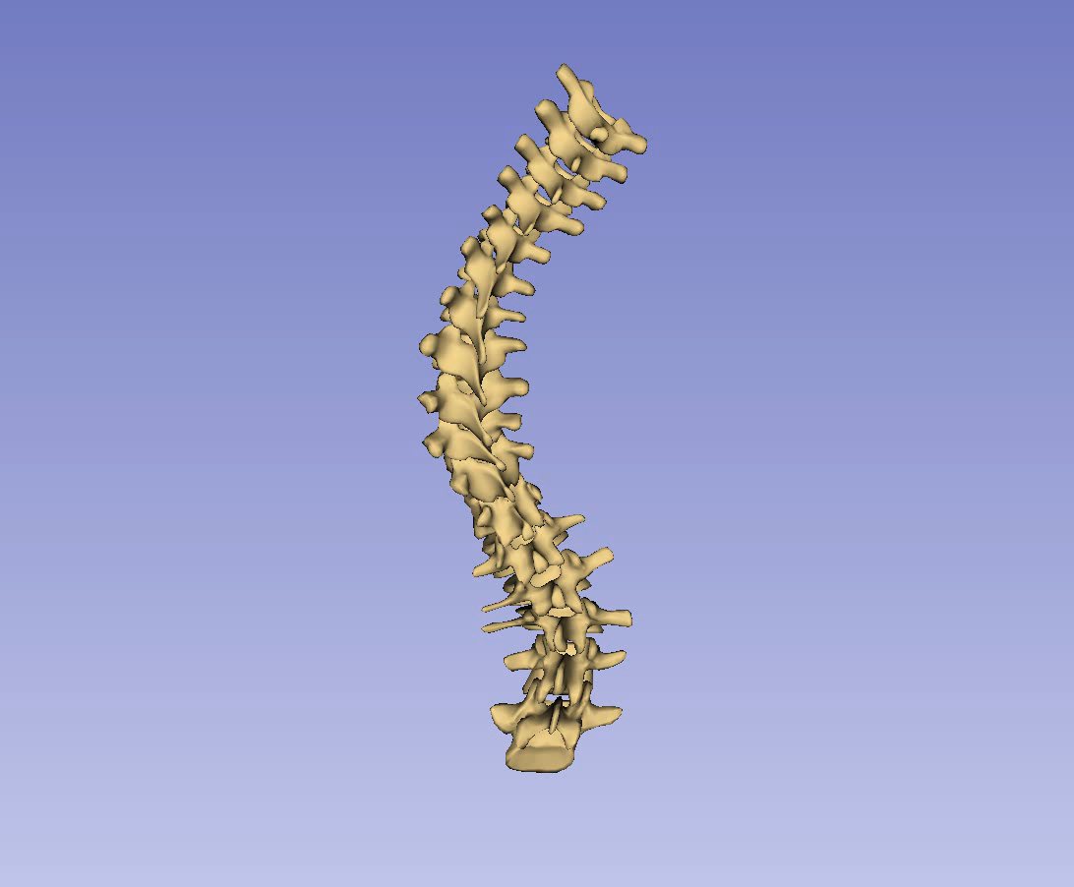
Ch. 2: Motivation Scoliosis visualization
Patient-specific treatments require 3D assessment [Kalichman2016].
Ultrasound assessment methods lack 3D visualization.

Slide 6

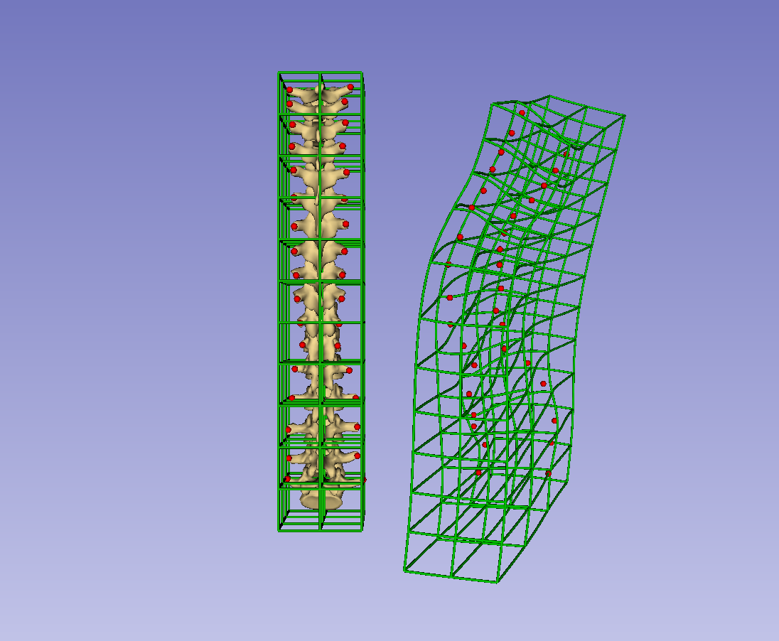
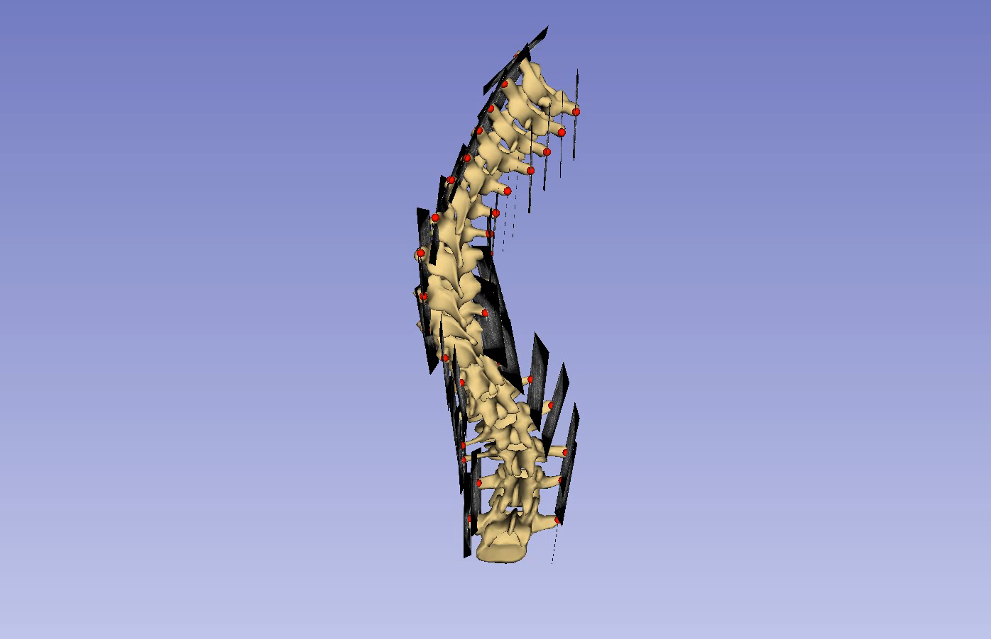
Ch. 3: Landmark registration for visualization
A landmark-based thin-plate spline registration can be used to warp a healthy-shaped model onto patient anatomy [Church2017a].

Slide 7
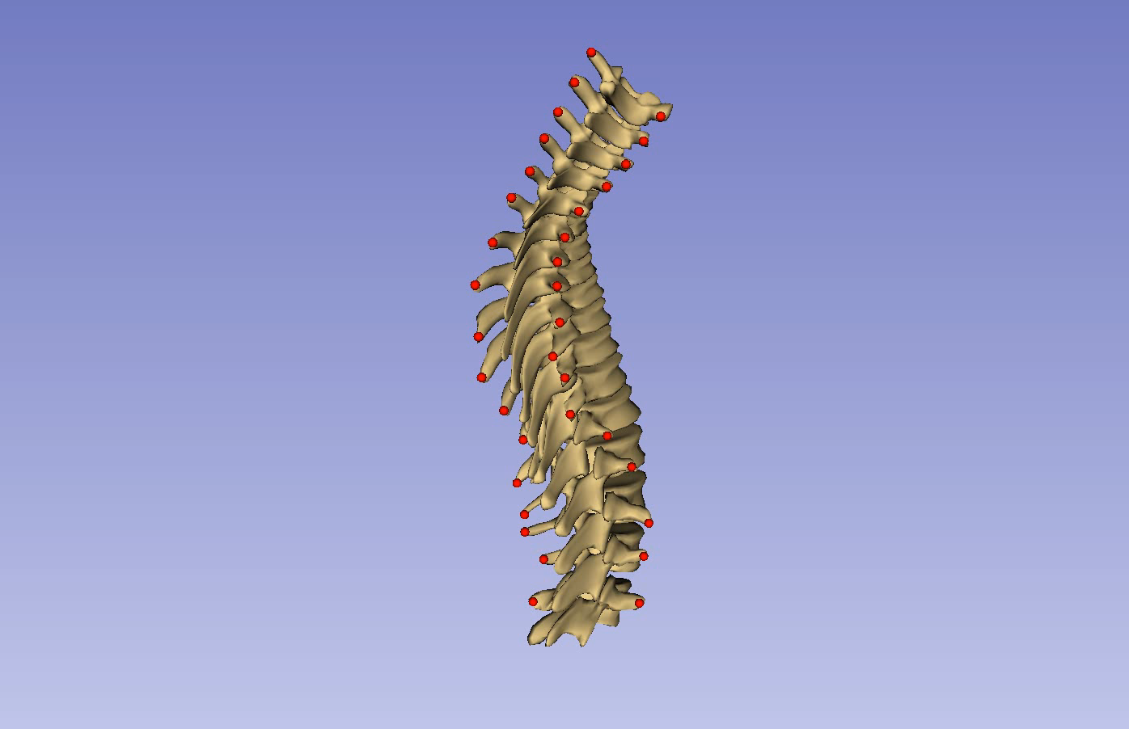
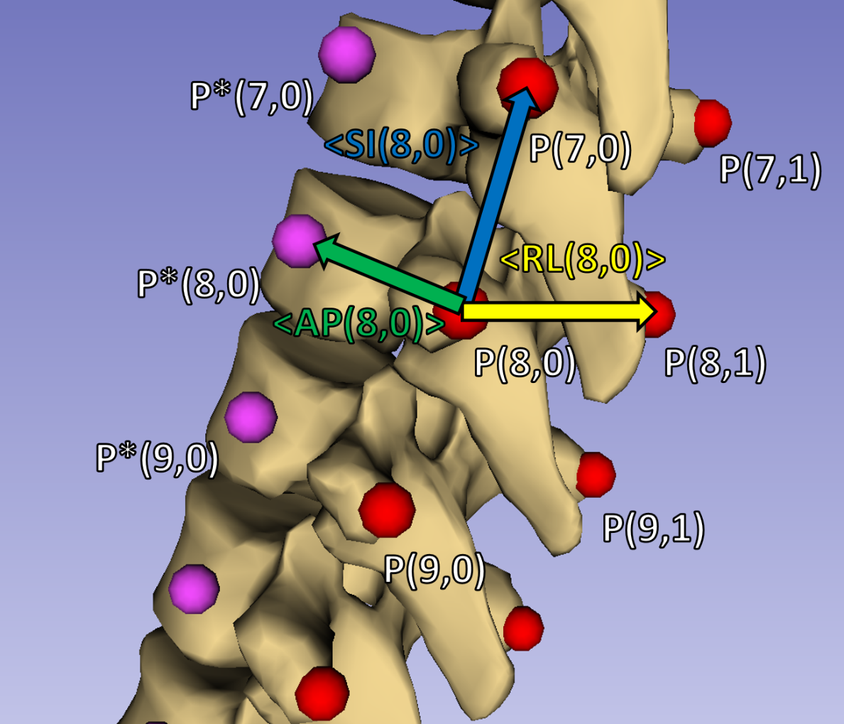
Ch. 3.4: Registration constraint
Algorithmic supplementation of landmarks with anchor points required to constrain warping

Slide 8
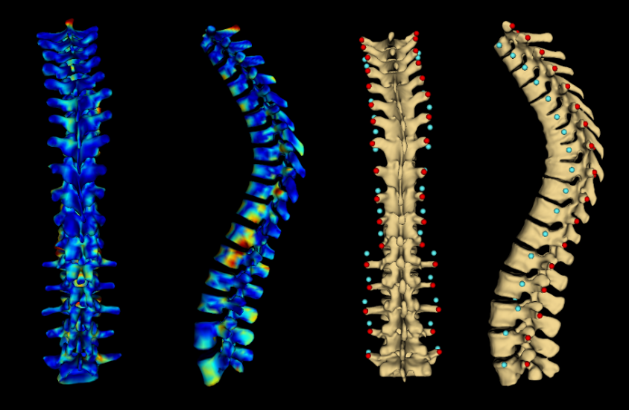
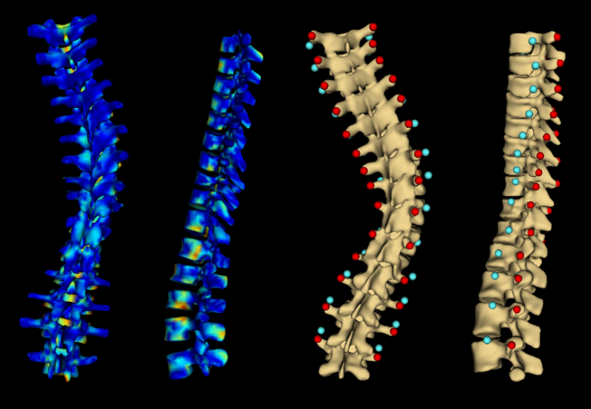
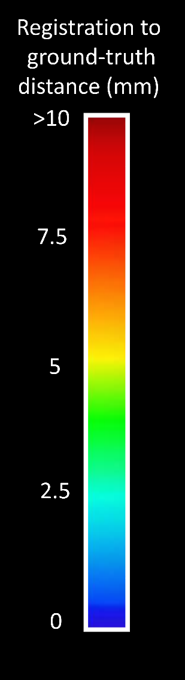
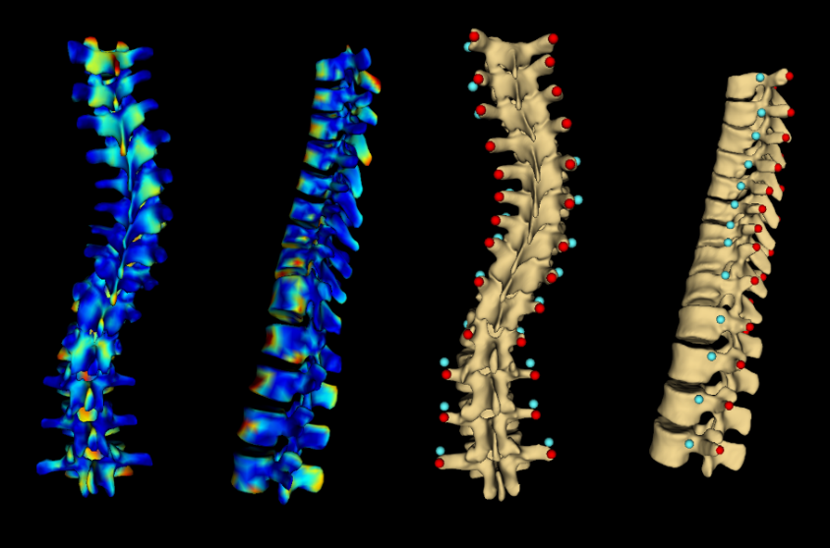
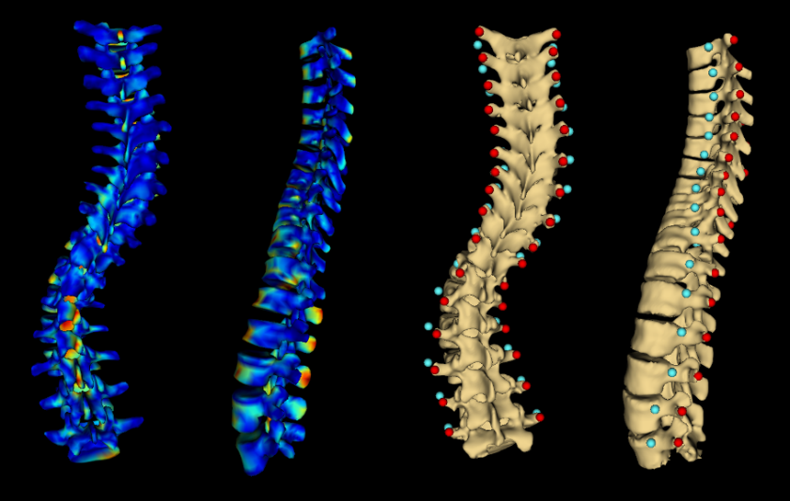
Ch. 3.5: Validation
dfass

Slide 9
Ch. 4: Landmark generation from ultrasound
Manual landmark identification is the most time-consuming step of proposed visualization method.
Automatically generating landmark from ultrasound could substantially reduce operator interaction.

Slide 10
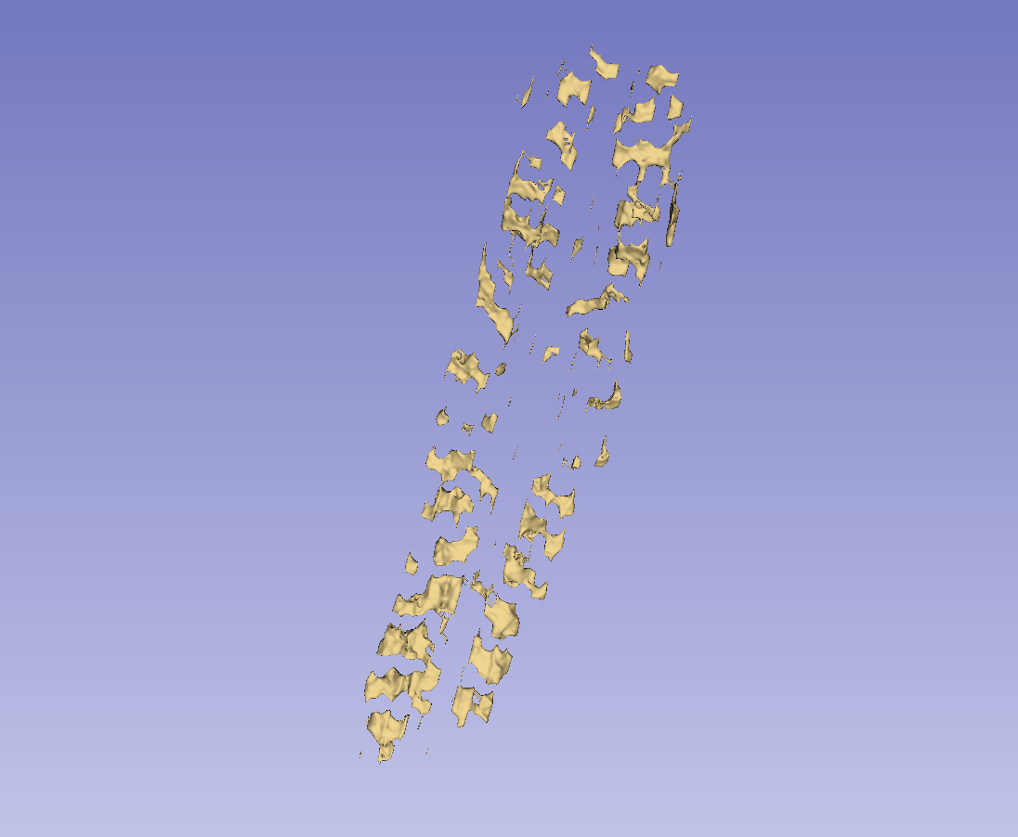
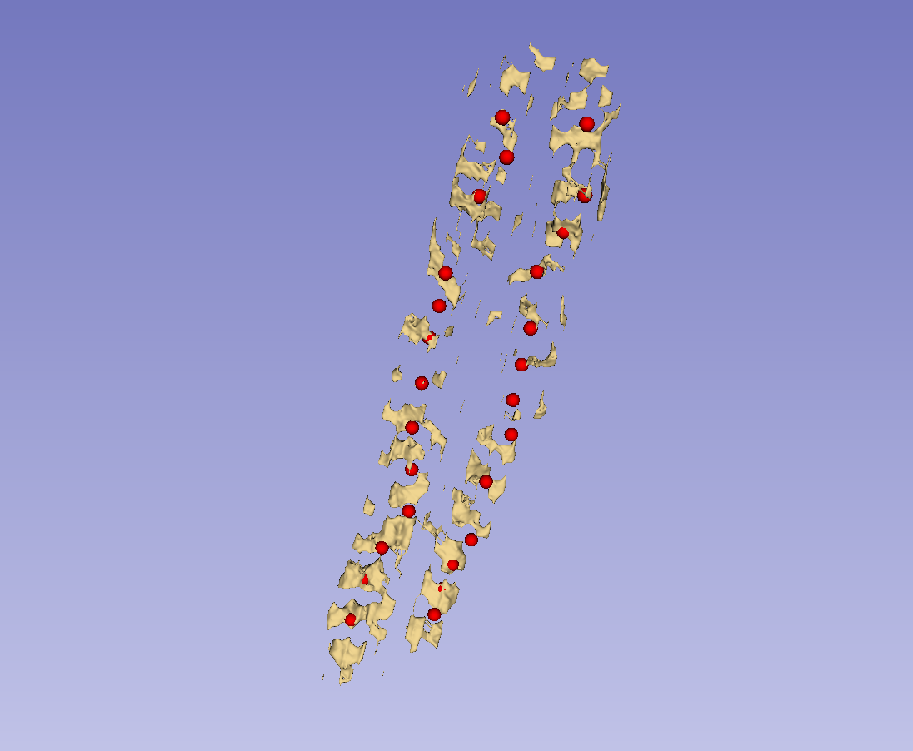
Ch. 4.2: Segmentation under-sampling
Bone segmentations can be reduced to landmark sets with k-means algorithm.

Slide 11
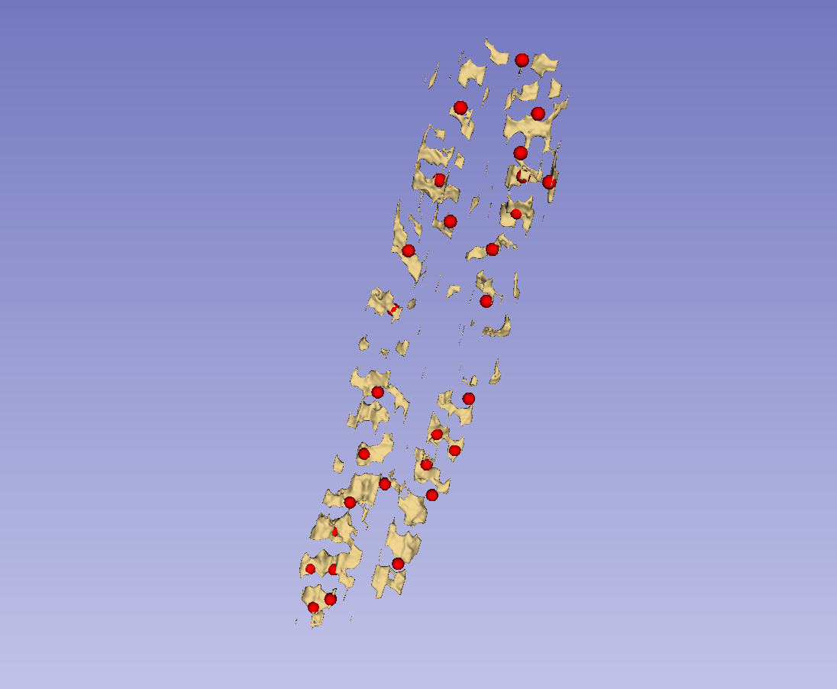
Ch. 4.3: Landmark refinement
Landmarks from k-means may have several defects:
Multiple points on a single landmark
Missing points on landmarks
Incorrectly placed points

Slide 12
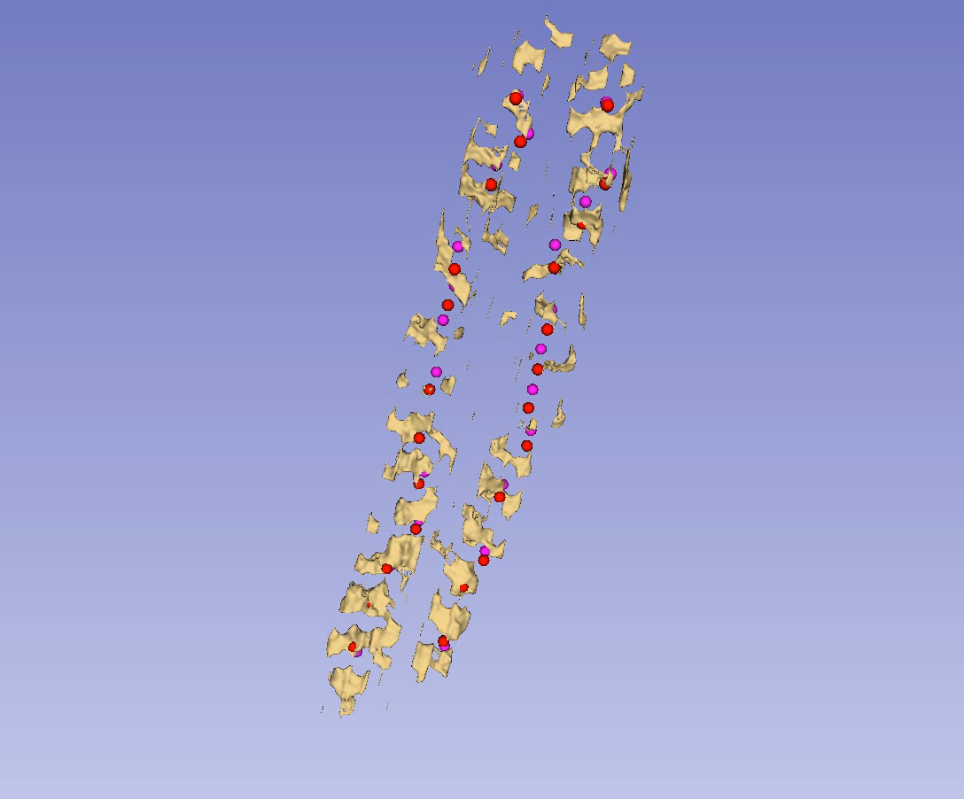
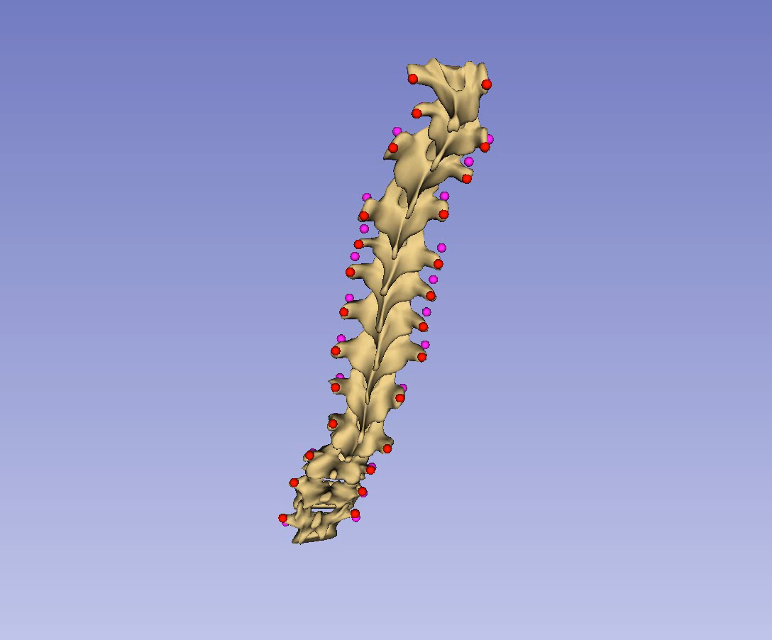
Ch. 4.5: Full workflow test cases

Slide 13
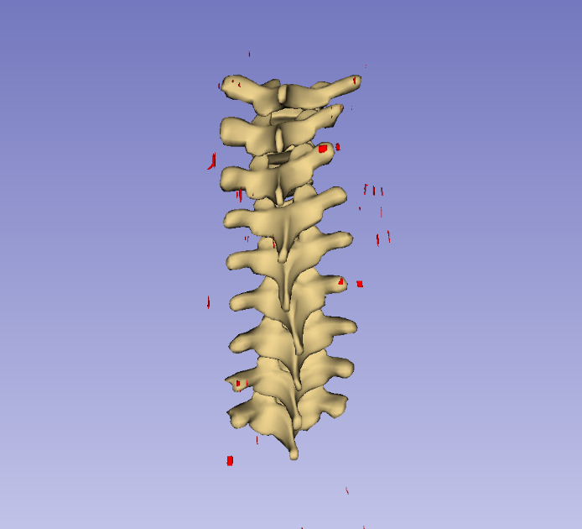
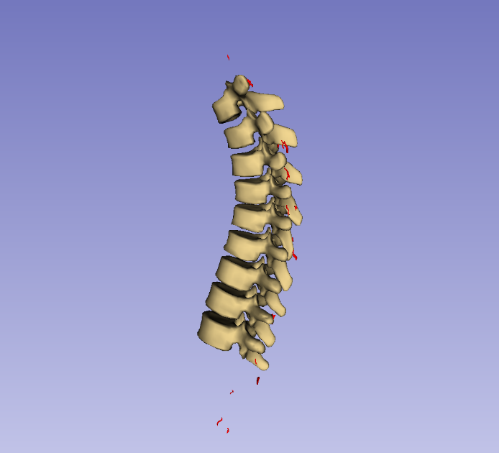
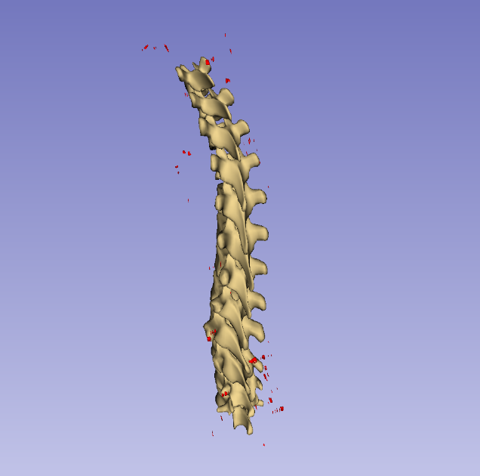
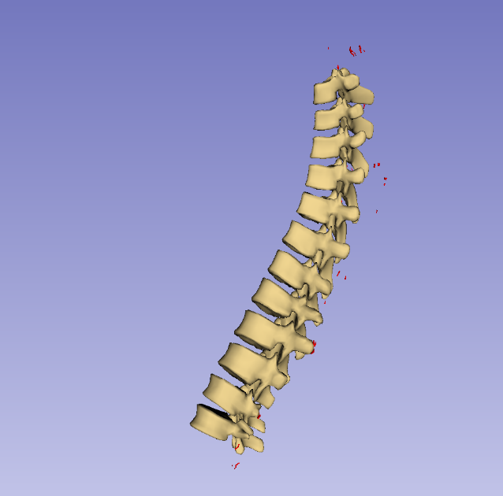
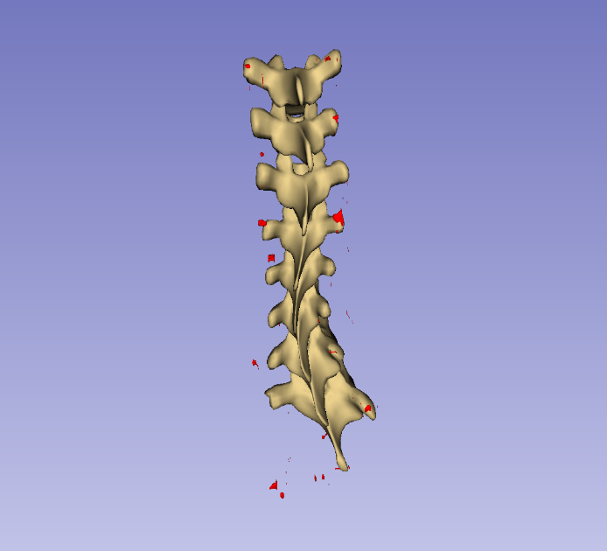
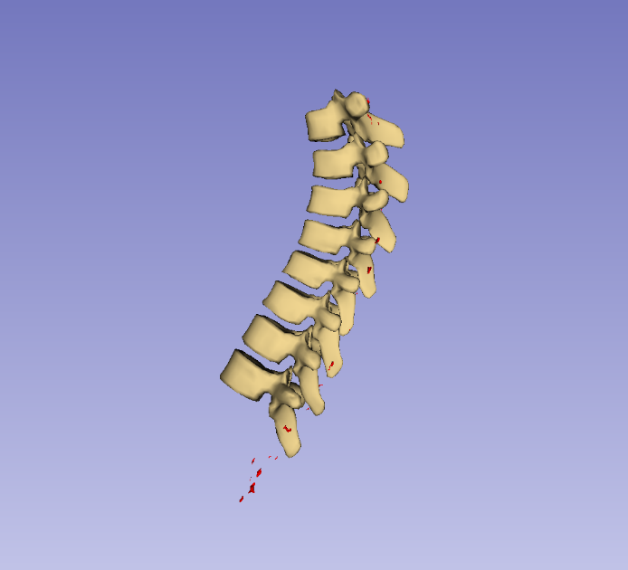
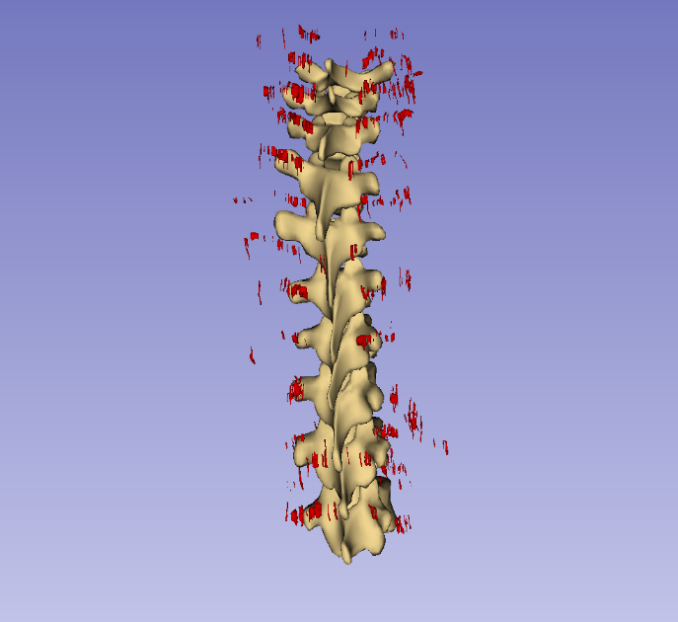
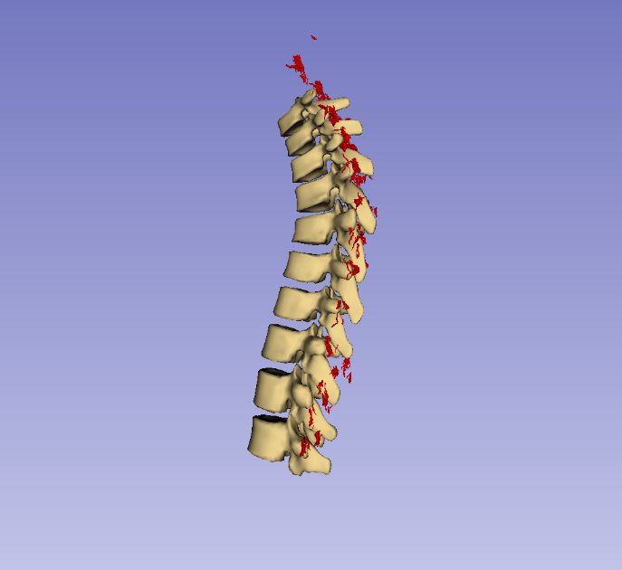
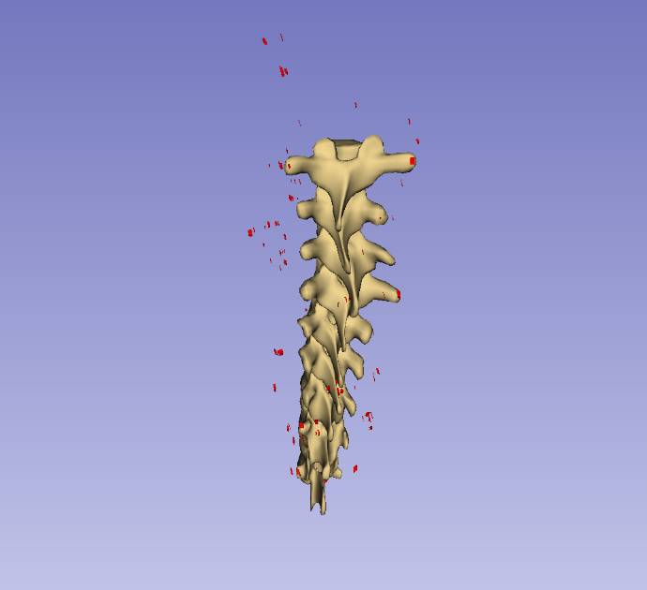
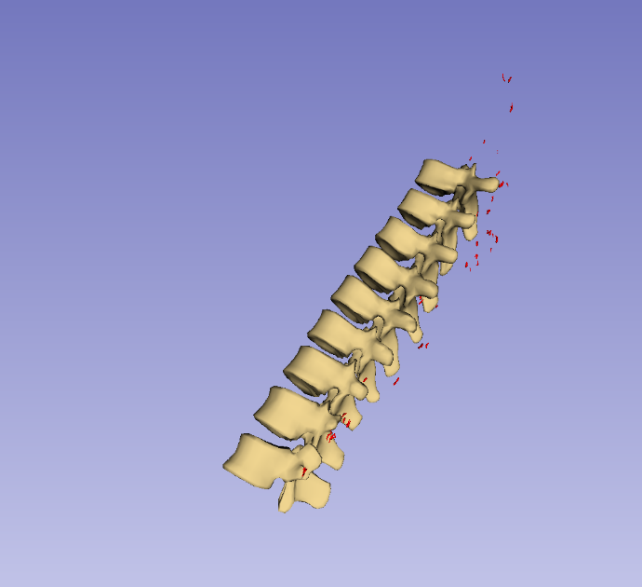
Ch. 4.5: Full workflow test cases

Slide 14
Conclusions
Method for generating 3D patient-specific spinal visualizations from ultrasound-accessible landmarks developed and validated.
Landmark locations can be estimated automatically and refined with modest user interaction.
Combination of presented methods bridges gap between ultrasound and 3D visualization.

Slide 15
Ongoing work
Application-specific validation [Baum2018]
Improving segmentation method
Investigating surface registration method

Slide 16
Posters and publications
B. Church, A. Lasso, C. Schlenger, D. P. Borschneck, P. Mousavi, G. Fichtinger and T. Ungi, "Visualization of scoliotic spine using ultrasound-accessible skeletal landmarks," in Proceedings of SPIE, Orlando, 2017. [Church2017a]
B. Church, A. Lasso, C. Schlenger, D. P. Borschneck, P. Mousavi, G. Fichtinger, T. Ungi, “Scoliosis visualization using transverse process landmarks,” poster at ImNO 2017. [Church2017b]
C. Pinter, B. Travers, Z. Baum, S. Kamali, T. Ungi, A. Lasso, B. Church and G. Fichtinger, “Real-time transverse process detection in ultrasound,” in Proceedings of SPIE, Houston, 2018. [Pinter2018]
Z. Baum, T. Ungi, A. Lasso, B. Church, C. Schlenger, G. Fichtinger, "Visual aid for identifying vertebral landmarks in ultrasound," in Proceedings of SPIE, Houston, 2018. [Baum2018]

Slide 17
Thank you!
Questions?

Slide 18
References
[Baum2018] Z. Baum, T. Ungi, A. Lasso, B. Church, C. Schlenger, G. Fichtinger, "Visual aid for identifying vertebral landmarks in ultrasound ," in Proceedings of SPIE, Houston, 2018.
[Brudfors2015] M. Brudfors, A. Seitel, A. Rasoulian, A. Lasso, V. A. Lessoway, J. Osborn, A. Maki, Robert N. Rohling, P. Abolmaesumi, “Towards real-time, tracker-less 3D ultrasound guidance for spine anaesthesia,” Int J CARS, vol. 10, p. 855-865, 2015.
[Chen2013] W. Chen, E. H. M. Lou, P. Q. Zhang, L. H. Le and D. Hill, "Reliability of assessing the coronal curvature of children with scoliosis by using ultrasound images," J Child Orthop, vol. 7, p. 521–529, 2013.
[Church2017a] B. Church, A. Lasso, C. Schlenger, D. P. Borschneck, P. Mousavi, G. Fichtinger and T. Ungi, “Visualization of scoliotic spine using ultrasound-accessible skeletal landmarks," in Proceedings of SPIE, Orlando, 2017.
[Church2017b] B. Church, A. Lasso, C. Schlenger, D. P. Borschneck, P. Mousavi, G. Fichtinger, T. Ungi, “Scoliosis visualization using transverse process landmarks,” poster at ImNO 2017.
[Doody2000] M. M. Doody, J. E. Lonstein, M. Stovall, D. G. Hacker, N. Luckyanov and C. E. Land, "Breast Cancer Mortality After Diagnostic Radiography," SPINE, vol. 25, no. 16, p. 2052–2063, 2000.
[Kalichman2016] L. Kalichman, L. Kendelker and T. Bezalel, "Bracing and exercise-based treatment for idiopathic scoliosis," Journal of Bodywork & Movement Therapies, vol. 20, pp. 56-64, 2016.
[Pinter2018] C. Pinter, B. Travers, Z. Baum, S. Kamali, T. Ungi, A. Lasso, B. Church and G. Fichtinger, “Real-time transverse process detection in ultrasound,” in Proceedings of SPIE, Houston, 2018.
[Presciutti2014] S. M. Presciutti, T. Karukanda and M. Lee, "Management decisions for adolescent idiopathic scoliosis significantly affect patient radiation exposure," The Spine Journal, vol. 14, pp. 1984-1990, 2014.
[Purnama2010] K. E. Purnama, M. H. F. Wilkinson, A. G. Veldhuizen, P. M. A. v. Ooijen, J. Lubbers, J. G. Burgerhof, T. A. Sardjono and G. J. Verkerke, "A framework for human spine imaging using a freehand 3D ultrasound system," Technology and Health Care, vol. 18, p. 1–17, 2010.
[Ungi2014] T. Ungi, F. King, M. Kempston, Z. Keri, A. Lasso, P. Mousavi, J. Rudan, D. P. Borschneck and G. Fichtinger, "Spinal Curvature Measurements by Tracked Ultrasound Snapshots," Ultrasound in Med. & Biol., vol. 40, no. 2, pp. 447-454, 2014.

Slide 19
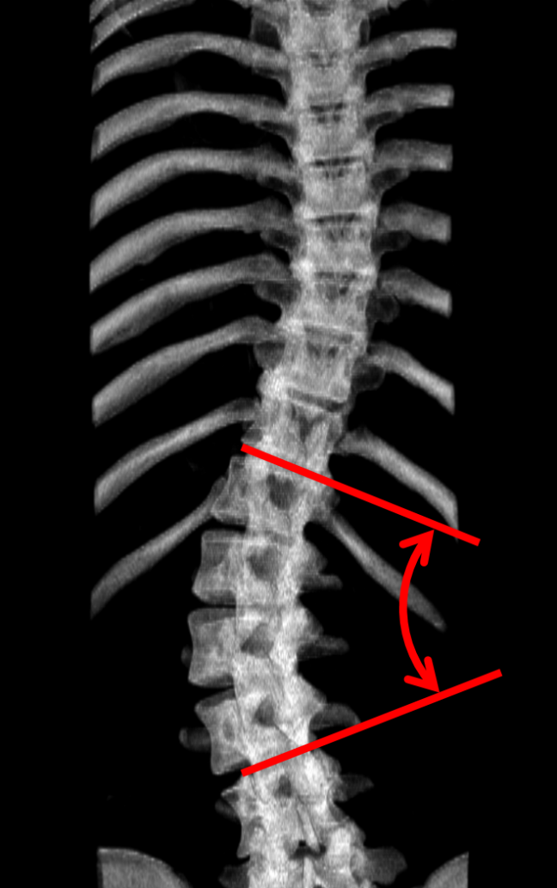
Background – X-ray
X-ray uses ionizing radiation
X-ray assessment is limited to planar views

Slide 20
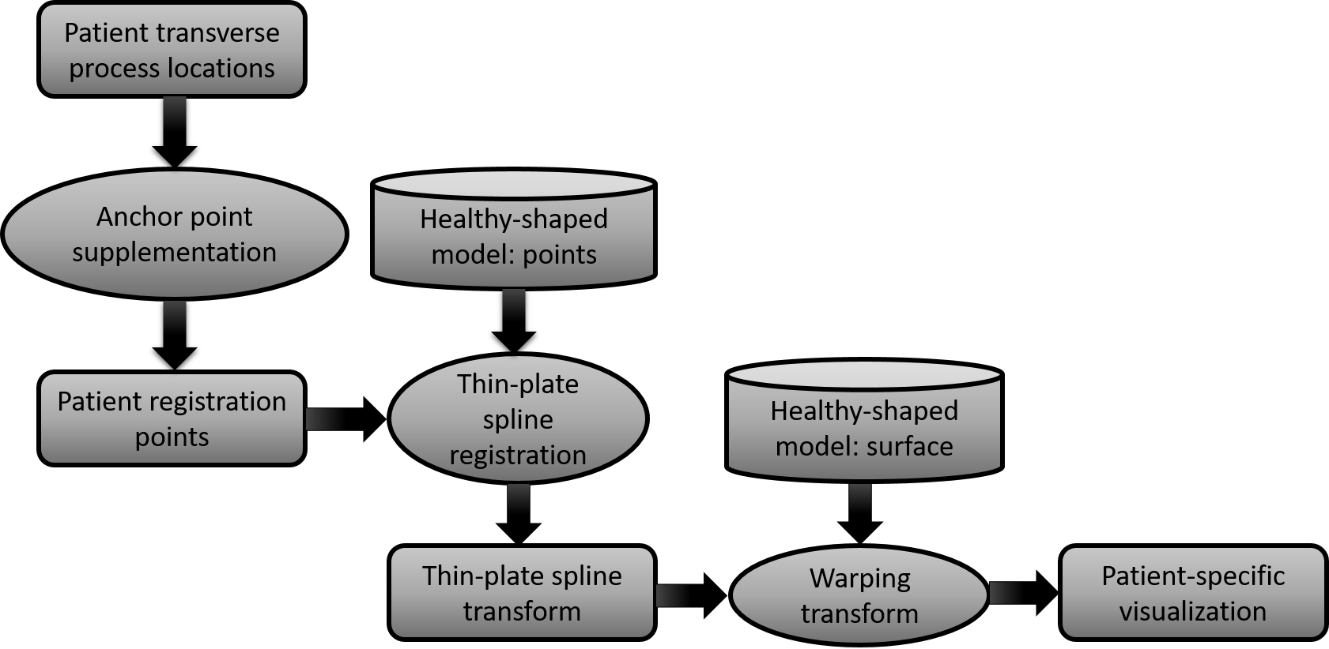
Visualization - Overview

Slide 21
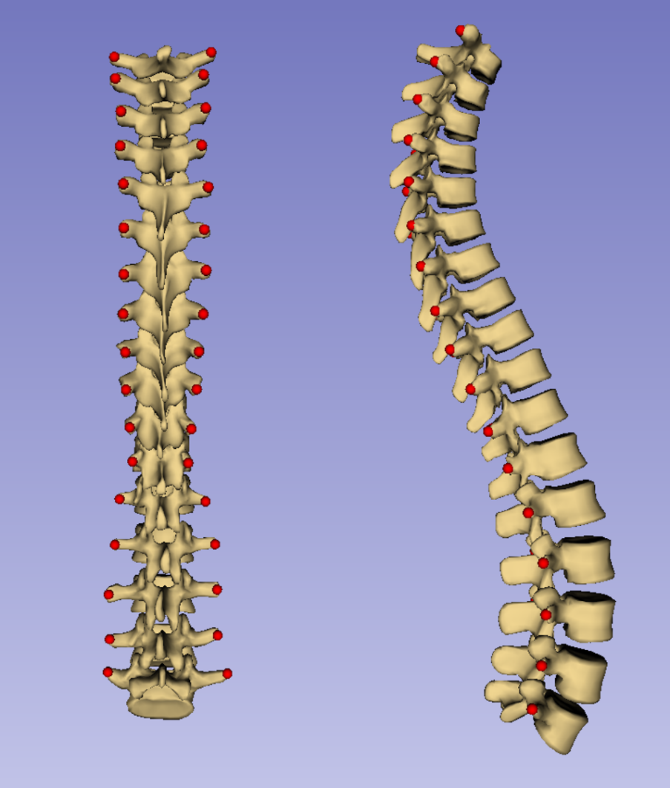
Visualization – Healthy model
Healthy-shaped model consists of landmarks corresponding to patients’ and a surface to be warped

Slide 22
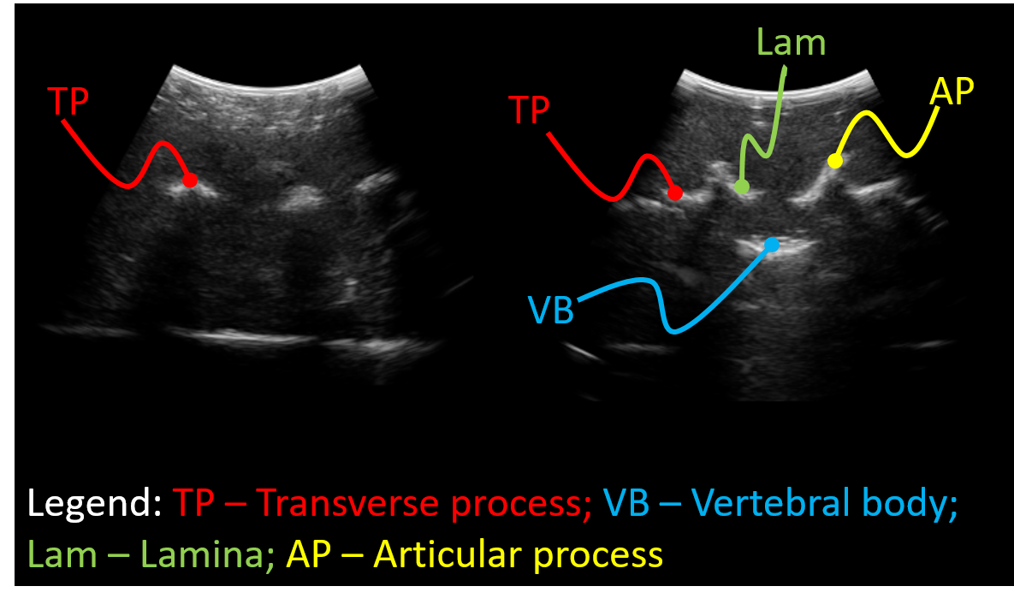
Visualization - Landmarks
Transverse processes were chosen as landmarks for suitability with ultrasound

Slide 23
Visualization – Results
Visualizations were generated from 16 scoliotic patients’ transverse process locations
Accuracy of visualizations was assessed by comparing to CT ground-truth

Slide 24
Visualization – Results
Hausdorff distances and Dice coefficient describe accuracy quantitatively.
Patient # | Maximum Hausdorff (mm) | Average Hausdorff (mm) | Dice coefficient
1 | 16.3 | 2.2 | 0.63
2 | 19.7 | 2.5 | 0.63
3 | 20.0 | 2.0 | 0.63
4 | 13.1 | 2.3 | 0.59
5 | 16.3 | 2.5 | 0.58
6 | 17.9 | 2.5 | 0.57
7 | 16.0 | 2.4 | 0.59
8 | 15.1 | 2.9 | 0.53
9 | 11.4 | 2.0 | 0.69
10 | 9.4 | 1.7 | 0.69
11 | 17.1 | 2.4 | 0.57
12 | 14.0 | 2.4 | 0.64
13 | 14.8 | 2.7 | 0.53
14 | 14.6 | 2.5 | 0.61
15 | 13.3 | 2.0 | 0.63
16 | 15.3 | 1.8 | 0.58
Average | 15.3 | 2.3 | 0.61
Standard deviation | 2.7 | 0.3 | 0.04

Slide 25
Visualization – Discussion
Visualizations capture 3D deformation
Inaccuracies mainly at boundaries and vertebral bodies

Slide 26
Visualization – Discussion
Method has not been validated for navigation
Method has been used in work by Baum et al.

Slide 27
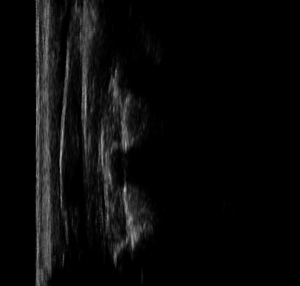
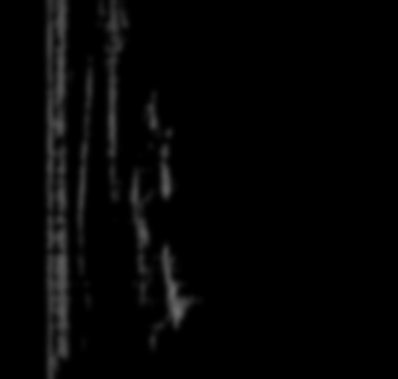
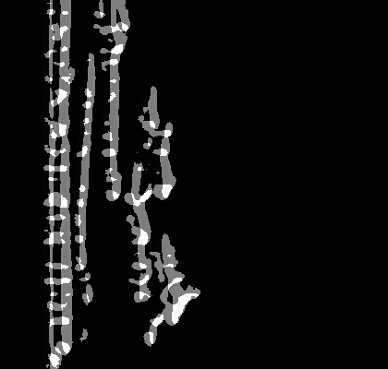
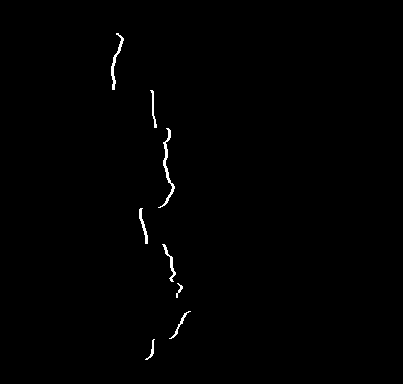
Landmark generation - Segmentation
A new PLUS tool was used to segment bones from spinal ultrasound

Slide 28


Landmark generation - Segmentation
The method checks for acoustic shadows to determine presence of bone

Slide 29
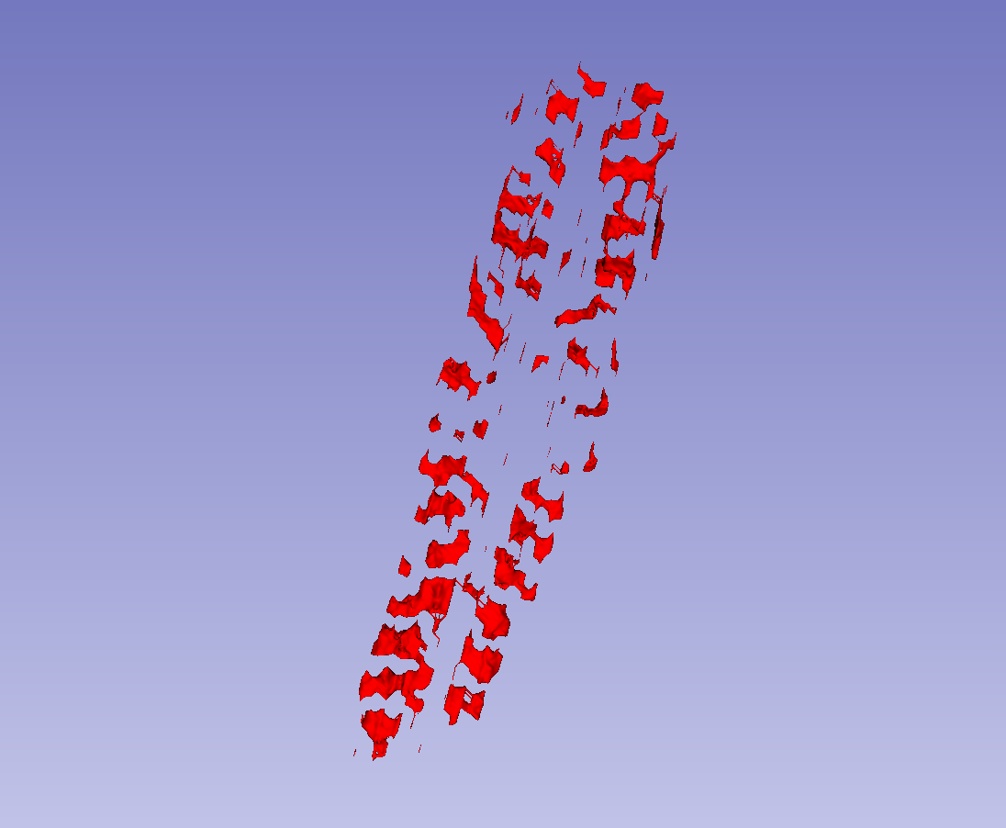
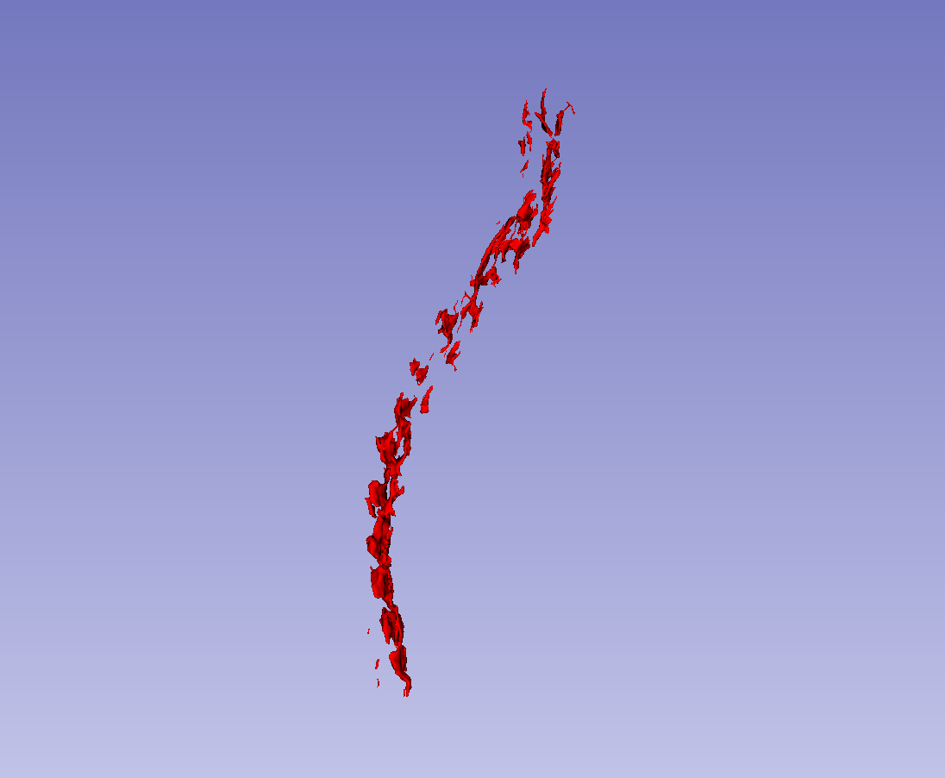
Landmark generation - Segmentation
The segmentation can be rendered as a surface

Slide 30
Landmark generation – Right-left
Defects are tested for and repaired side-wise
Points must be identified as belonging to right or left side of spine

Slide 31
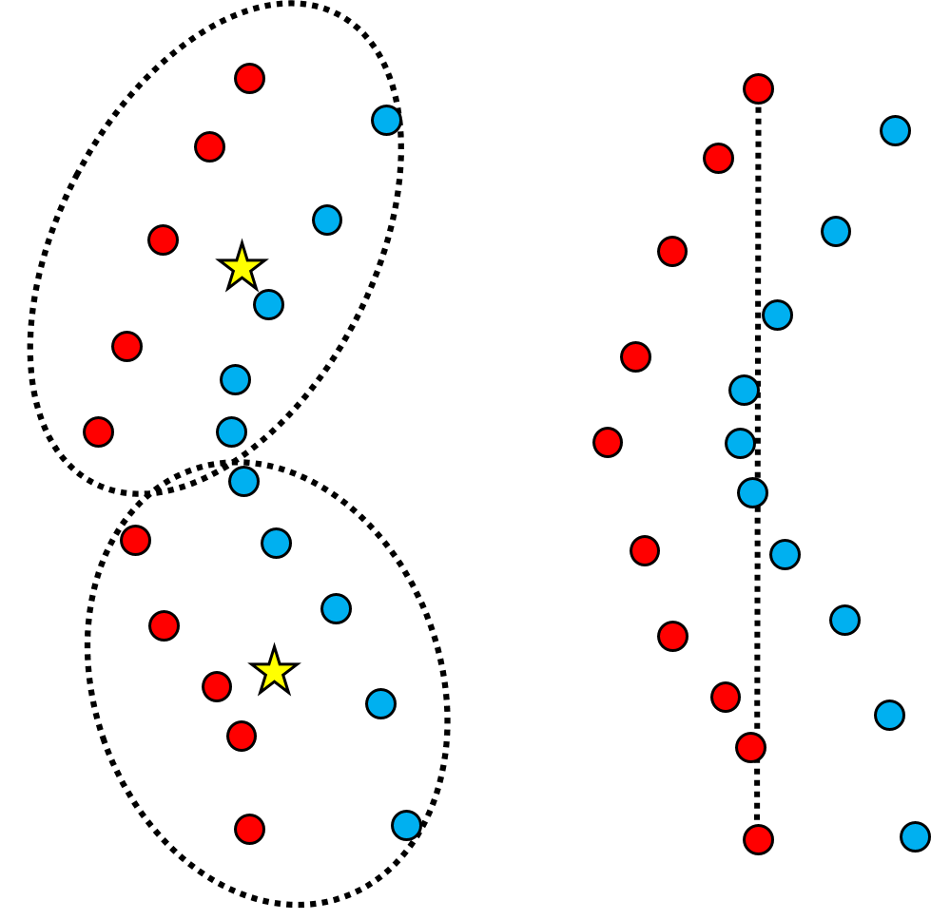
Landmark generation – Right-left
Un-normalized left-right landmark distribution not immediately separable
Curvature can prevent linear separation

Slide 32
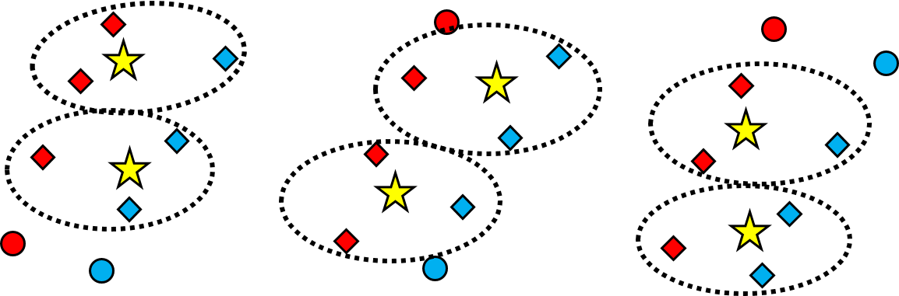
Landmark generation – Right-left
k-means classifies points landmarks window by window

Slide 33
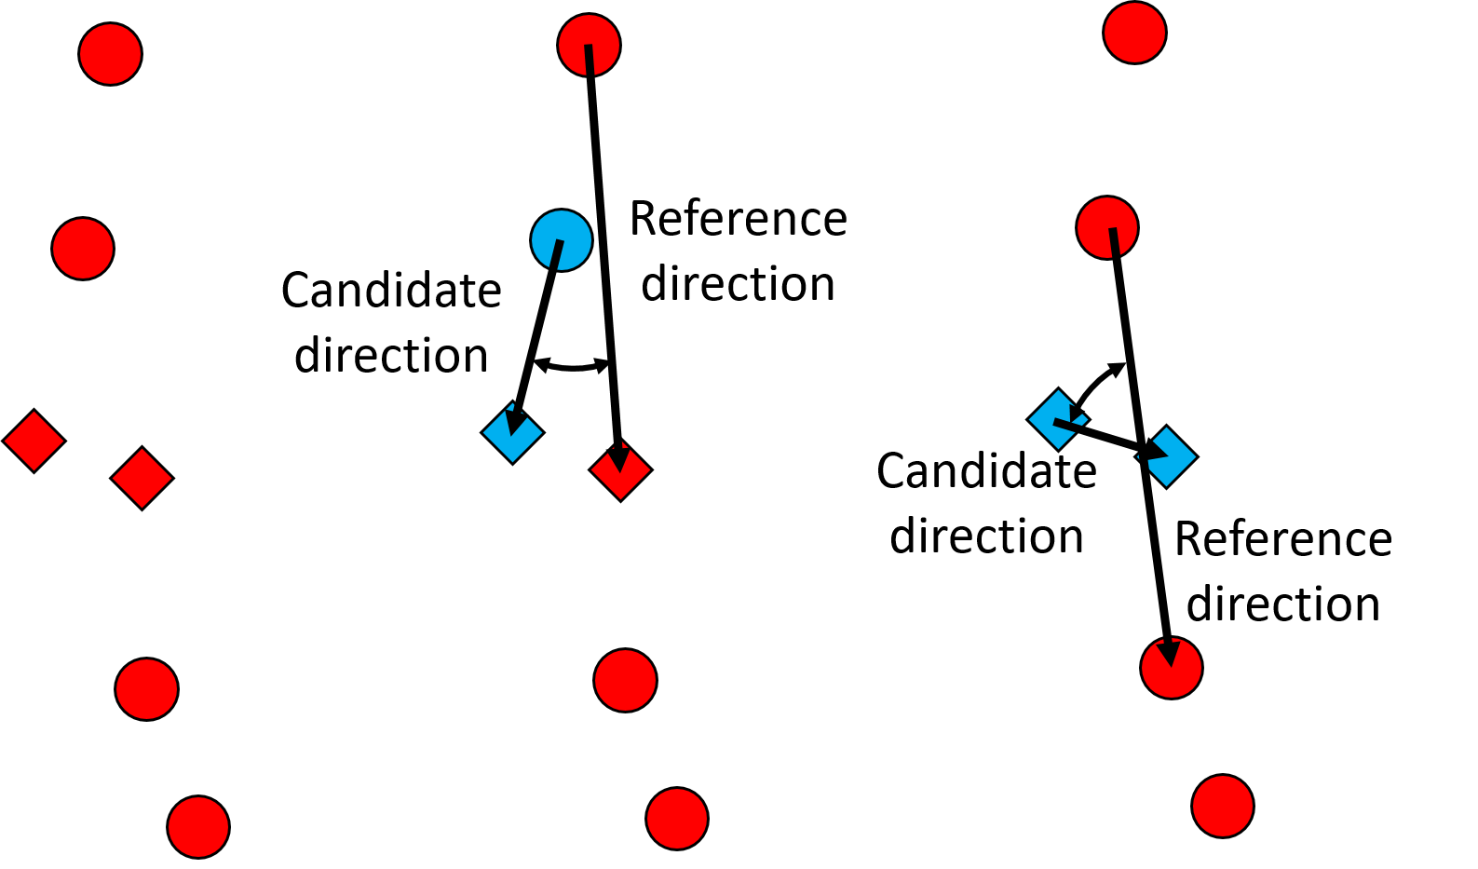
Landmark generation – Duplicates
Multiple points placed on a single landmark are identified by angles between inter-point vectors

Slide 34
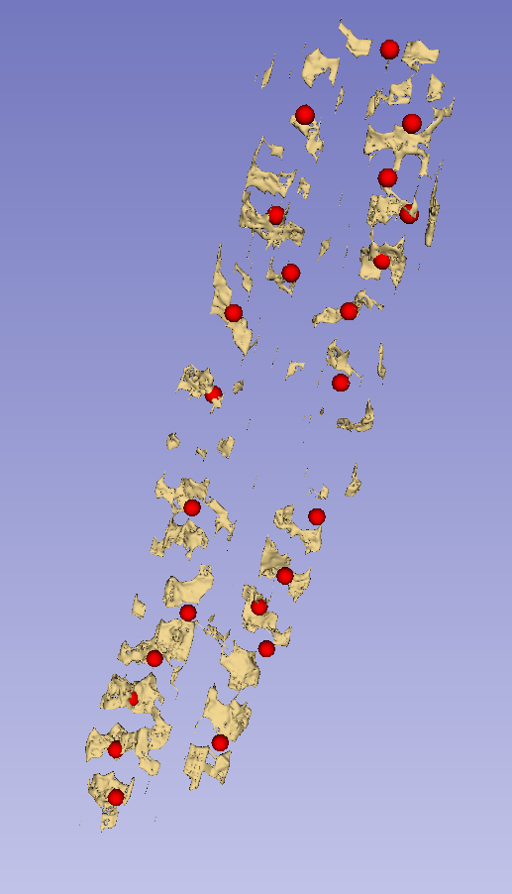
Landmark generation – Duplicates

Slide 35
Landmark generation – Omissions
Inter-landmark interval length are compared locally and globally
Unusually long interval lengths indicate omissions

Slide 36
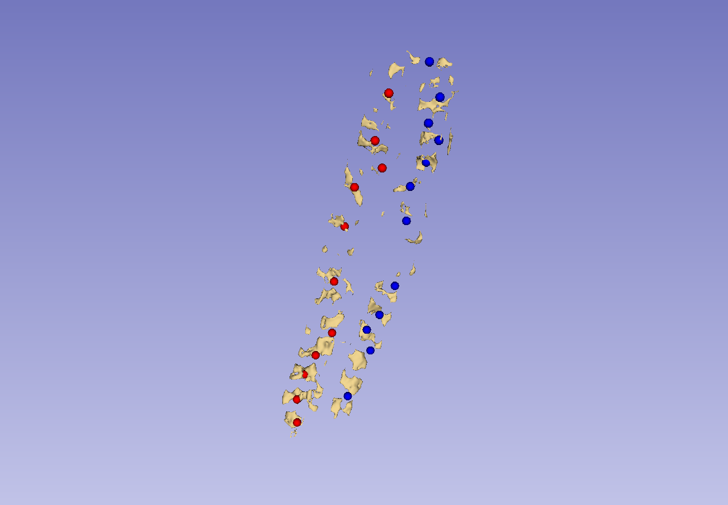
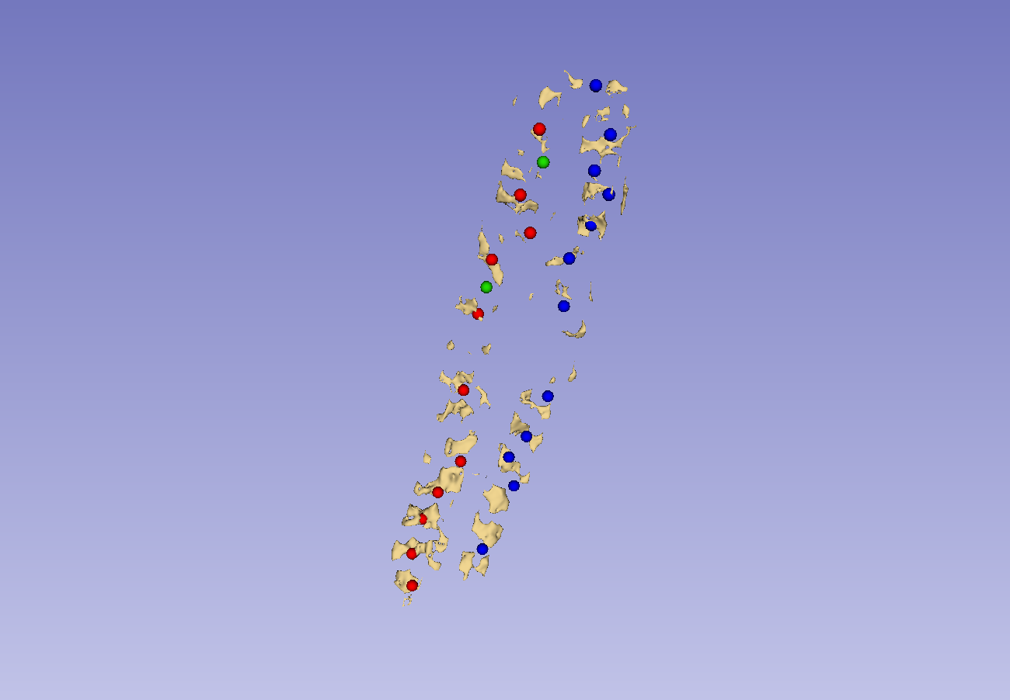
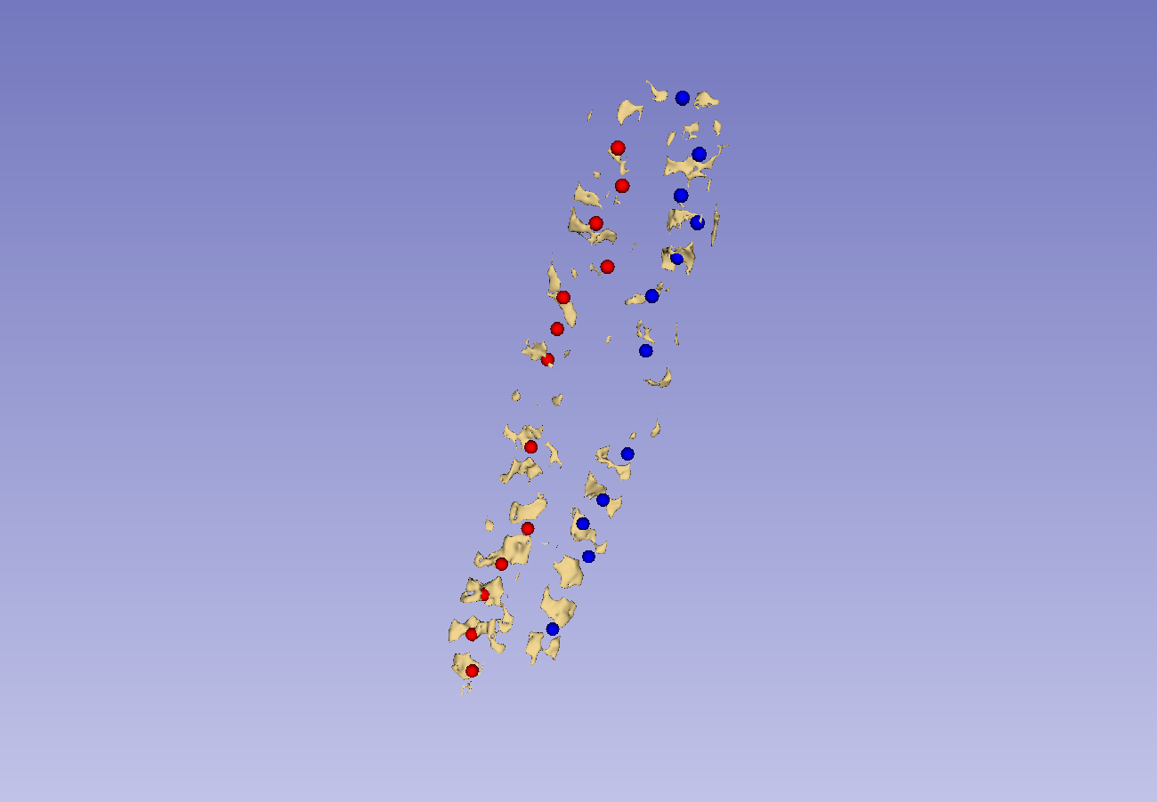
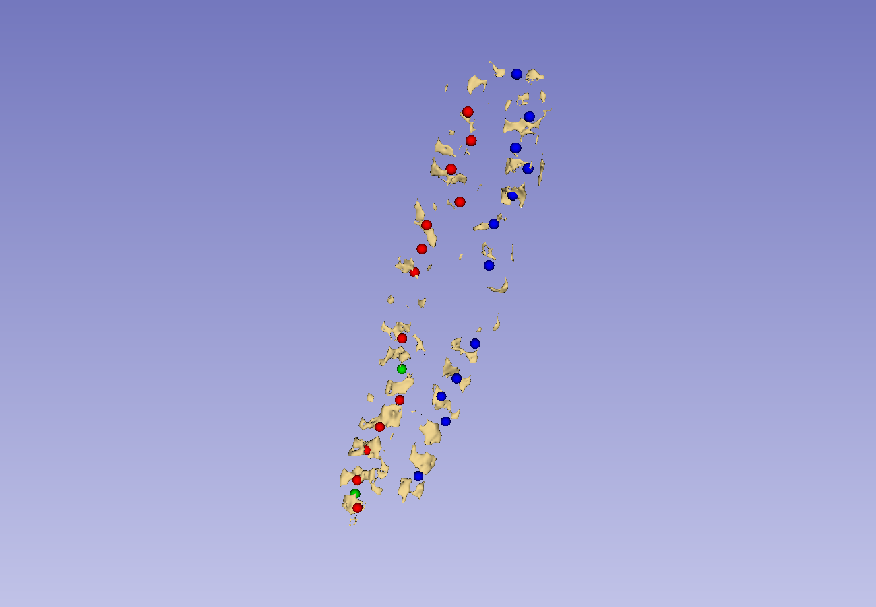
Landmark generation – Omissions

Slide 37




Landmark generation – Omissions

Slide 38




Landmark generation – Omissions

Slide 39

Landmark generation – Outliers
Outliers are identified similarly to duplicates, but as individual points

Slide 40



Landmark generation – Outliers

Slide 41



Landmark generation – Outliers

Slide 42


Landmark generation – Boundaries
Defects are corrected by interpolation
Overhanging points must be removed from both sides

Slide 43

Full workflow
5 volunteers were scanned
Scans were segmented
Landmarks were generated from segmentations
Visualizations were produced from landmarks

Slide 44





Full workflow

Slide 45





Full workflow

Slide 46





Full workflow

Slide 47





Full workflow

Slide 48





Full workflow

